Slide 1
Exploring Your Personality and Major
Chapter 2
Chapter 2

Slide 2
Job Jar Activity
Introducing the assessments

Slide 3

What is Personality Type?

Slide 4

Personality Type
We are born with certain preferences that we develop over a lifetime.
Each person is different and unique just like fingerprints or snowflakes.
Knowing your personal strengths will increase self-understanding and help you make a good choice of a major.

Slide 5
TruTalent Personality Assessment
Use your access code to set up an online portfolio and take this assessment.
The assessments are integrated into the online versions of the text.
Your results are linked to matching careers.

Slide 6
Directions
Find a time when you are not tired or rushed.
There are no right or wrong answers.
Answer quickly giving your first impression. Do not over analyze.
You will have a chance to look at your profile and change it if you think it is not correct.

Slide 7
Directions
Answer the questions honestly to get the best results.
Answer the questions how you usually are when you are not stressed.
Do not answer the questions:
  How you want to be
  How you have to be at home, work or school
  How others want you to be

Slide 8
Important
There are no good or bad types. Each type has personal strengths that can be used in the workplace.
Answer the questions honestly to get the best results. If you do not answer the questions honestly, the career suggestions will not be a good match for you.

Slide 9
Directions
The test does not measure:
  Intelligence
  Psychological or emotional health
The assessment identifies your personal strengths and matches them to possible careers.

Slide 10
4 Dimensions of Personality Type
Extravert or Introvert
How we interact with the world and
where we place our energy
Sensing or Intuition
The kind of information we naturally
notice and remember
Thinking or Feeling
How we make decisions
Judging or Perceptive
Whether we prefer to live in a structured
or more spontaneous way

Slide 11
Extravert or Introvert
How we interact with the world and where we place our energy
E_____________________________|____________________________I
Extraversion Introversion

Slide 12
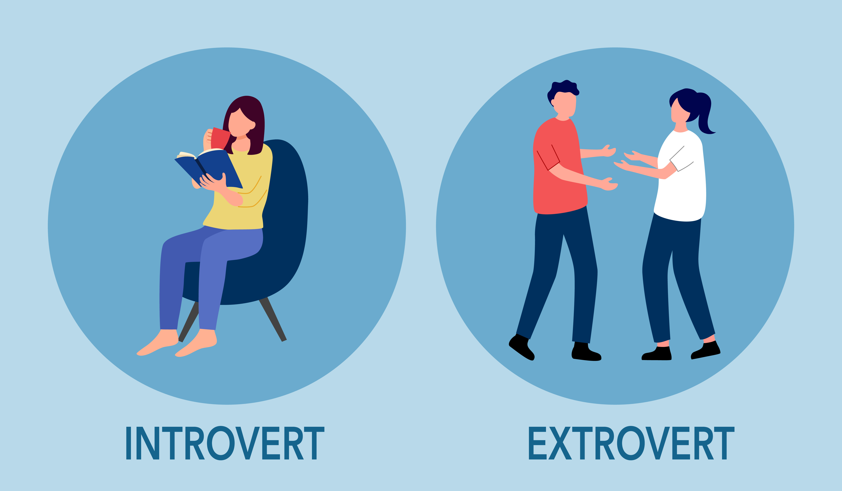
Personality Type
Extravert Introvert
How we interact with the world and
where we place our energy

Slide 13
Personality and Work Environment
Extraverts
Introverts
Are career generalists
Like variety and action
Are good at communication
Like to talk while working
Learn by talking with others
Like to work as part of a team
Are career specialists
Like quiet for concentration
Think before acting
Prefer written communication
Learn by reading
Prefer working alone

Slide 14
Sample Careers
Extravert
Customer service
Sales
Public relations
Human resources
Physical therapist
Financial advisor
Business management
Introvert
Computer scientist
Software engineer
Scientist
Engineer
Accountant
Graphic designer
Pharmacist
Artist
Notes:
Here are some sample careers matching each type. We can see good opportunities for each type.

Slide 15


Activity: Talkers Vs Listeners
In the classroom, talkers volunteer to speak and do so frequently. Listeners are people who prefer to stay quiet and rarely join in on the discussions. I want you to identify yourself as a:
Talker or Listener

Slide 16
Group Activity:
Talkers and Listeners
Talker
Listener
What made me a talker?
How can I develop my listening skills?
How can I help listeners talk more?
What made me a listener?
How can I develop my talking skills?
How can I help talkers listen more?

Slide 17
Sensing or Intuitive
The kind of information we naturally notice and remember
S_____________________________|___________________________N
Sensing Intuition

Slide 18
Personality and Work Environment
Sensing
Intuitive
Are realistic and practical
Like standard ways of doing the job
Focus on facts and details
Learn from experience
Like tangible outcomes
Use common sense
Like challenging and complex problems
Like new ways of doing the job
Focus on the big picture
Value creative insight, creativity, imagination and originality

Slide 19
Sample Careers
Sensing
Business executives
Accountants
Police and detectives
Judges
Lawyers
Computer programmers
Doctors and dentists
Interior decorators
Intuitive
Scientists
Engineers
Psychologists
Artists
Photographers
Actors
Professors
Writers
Notes:
Here are some sample occupations for each type. Note that there are good opportunities for each type.

Slide 20
Personality Exercise
Write about the picture for 3 minutes.

Slide 21
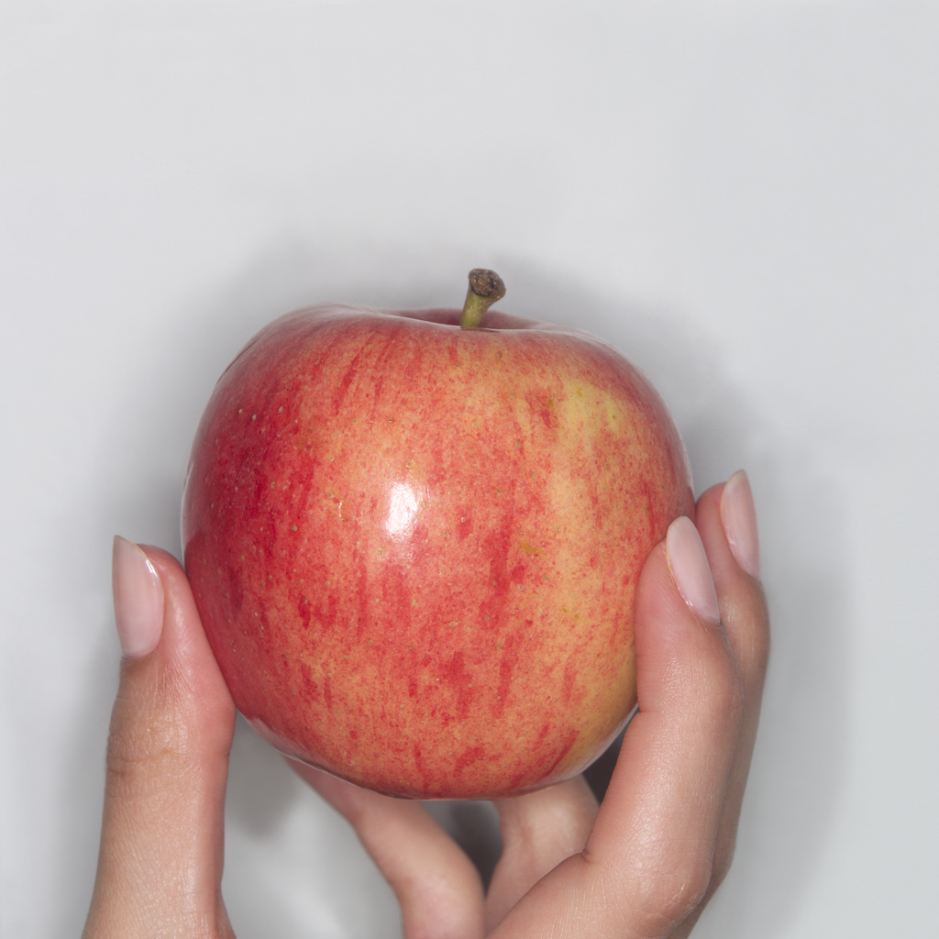
Activity
Notes:
Here is an example of what sensing type students have written in the past:
The apple is colored red and yellow. It is round, tasty, and healthy. It smells fresh and tastes good.
If you have a strong preference for sensing, you may have written something similar. Ask for volunteers to share results.
Here is an example of what intuitive student have written:
This apple has made a long journey. Its life began as a seed thrown into a desolate field by a young boy who was enjoying the apple on a summer night.
If you have a strong preference for intuitive, you may have written as creative story about the apple. Ask for volunteers to share results.

Slide 22
Thinking or Feeling
How we make decisions
T_____________________________|___________________________F
Thinking Feeling

Slide 23
Personality and Work Environment
Thinking
Feeling
Use logic to make decisions
Objective and rational
Like to be respected for their expertise
Follow policy
Firm-minded and sometimes critical
Value money, prestige and power
Use personal values to make decisions
Promote harmony
Relate well to others
Enjoy providing service to others
Value careers that make a contribution to humanity

Slide 24
Sample Careers
Thinking
Business managers and administrators
Lawyer
Judge
Computer Specialist
Scientist
Engineers
Mathematicians
Doctors and dentists
Military leaders
Feeling
Child care workers
Social workers
Counselors
Family practice physicians
Pediatricians
Interior decorators
Photographers
Artists and
musicians
Notes:
Here are some sample careers for each type.

Slide 25
Judging or Perceptive
Whether we prefer to live in a more structured or spontaneous way
J_____________________________|_____________________________P
Judging Perceiving

Slide 26


Personality type
Perceptive
Spontaneous
Judging
Planned and organized

Slide 27
Personality and Work Environment
Judging
Perceptive
Prefer structure and organization
Like to have the work finished
Prefer clear and definite assignments
Like to be spontaneous and go with the flow
Good at dealing with the unplanned and unexpected
Prefer flexible work environments
Stressed by deadlines

Slide 28
Sample Careers
Judging
Business executives
Managers
Accountants
Financial officers
Police and detectives
Judges
Lawyers
Computer programmers
Military leaders
Perceptive
Pilots
Athletes
Paramedics
Police and detective work
Forensic pathologists
Engineers
Scientists
Carpenters
Artists and musicians
Notes:
Here are some sample occupations for each type.

Slide 29
Group Activity: J and P Exercise:
Where do you stand?
  I can play anytime
  I have to finish my work before I play

Slide 30
Personality Type
Personality type affects:
Decision Making
Time Management
Money Management

Slide 31

Personality and Decision Making
Introvert
Extravert
Thinks before acting
Sometimes acts before thinking

Slide 32
Personality and Decision Making
Intuitive
Sensing
Develops theories and uses intuition to come up with ingenious solutions
Applies personal experience and comes up with practical and realistic solutions

Slide 33
Personality and Decision Making
Thinking
Feeling
Solve problems with logic
Use impersonal and objective criteria
Make firm decisions since they are based on logic
Consider human values and motives in making a decision
Consider carefully how decisions will affect other people
Want to make an agreeable decision

Slide 34
Personality and Decision Making
Judging
Perceptive
Is very methodical and cautious in making decisions
Once they have gone through the steps, they make the decision quickly to get things finished.
Wants to look at all the possibilities before making a decision
Wait to make the decision until they have considered all possible options

Slide 35

Personality
Managing Time and Money

Slide 36
Personality and Time Management
Judging
Perceptive
Good at time management
Use schedules and plan their time
Relax after the project is completed
Need to learn time management skills
Don’t finish projects because they are interested in looking at all the possibilities
Procrastinate
Get distracted

Slide 37
Personality and Money
Judging types excel at financial planning. They are often business majors.
Feeling types are not very money conscious. They often are attracted to lower paying jobs that serve others.

Slide 38
Your Personality and Learning Strategies

Slide 39
Extraverts
Learn best when in action
Value physical activity
Like to study with others

Slide 40
Extravert
Learn by talking.
Discuss what you have learned with others.
Like variety and action. Take frequent breaks and do something active.

Slide 41
Caution!
Extraverts can get so distracted by activity and socialization that the studying does not get done.

Slide 42
Introverts
Learn best by pausing to think
Value reading
Prefer to study individually
Need quiet for concentration

Slide 43
Introvert
Find a quiet place to study by yourself.
Plan to study for longer periods of time so you can concentrate.
Find places with minimal distractions such as the library.
Turn off the phone.

Slide 44
Caution!
This type may miss out on sharing ideas with others and the fun and social life of college.

Slide 45
Sensing
Seeks specific information
Memorizes facts
Values what is practical
Follows instructions
Likes hands-on experience
Wants clear assignments

Slide 46
Sensing
Good at mastering facts and details.
Think about practical applications to motivate yourself.
Ask, “How can I use this.”

Slide 47
Caution!
This type may miss the big picture or general outline by focusing too much on the facts and details. Make a general outline to see the relationship and meaning of the facts.

Slide 48
INtuitive
Seeks quick insights
Uses imagination to go beyond the facts
Values what is original
Likes theories
Reads between the lines
Independent thinkers

Slide 49
INtuitive
Good at learning concepts and theories
Ask yourself, “What is the main point?”

Slide 50
Caution!
Since this type focuses on general concepts and theories, they are likely to miss the details and facts. To learn the details, organize them into broad categories that have meaning for you.

Slide 51
Thinking
Wants objective material to study
Logic guides learning
Likes to critique new ideas
Finds flaws in an argument
Learns by challenge and debate
Wants logical presentations

Slide 52
Thinking
Thinking types are good at logic.
Ask yourself, “What do I think of these ideas?”
Debate or discuss your ideas with others.
Allow time to think and reflect on your studies.

Slide 53
Caution!
These types construct logical arguments and defend them. They may need to learn to respect the ideas of others, especially feeling types.

Slide 54
Feeling
Wants to be able to relate to the material personally
Personal values are important
Likes to please instructors
Learns by being supported and appreciated
Wants faculty who establish personal rapport with students

Slide 55
Feeling
Search for personal meaning to motivate yourself.
Help others to learn.
Whenever possible, choose classes that relate to your personal interests.
Find a comfortable environment for learning.

Slide 56
Caution!
This type may neglect studies because of time spent in helping others.
They may find it difficult to pay attention to material that is not personally meaningful.

Slide 57
Judging
Find ways to organize the material to learn it easier.
If possible, select instructors who present material in an organized way.
Set goals and use a schedule to motivate yourself.
Use a daily planner or to-do list.

Slide 58
Caution!
This type tends to be structured and controlled which can limit creativity.
They may be in conflict with others who are less organized.
They may be overachievers who get stressed easily.

Slide 59
Perceptive
Good at looking at the possibilities and keeping the options open.
Allow time to be thorough and complete your work.
Have fun while learning.
Study in groups with a mixture of perceptive and judging types.

Slide 60
Caution!
This type may work on too many projects at once.
Work on managing your time to meet deadlines.

Slide 61
Personality and your Instructors teaching style

Slide 62
Group Activity
Everyone has a combination of the these two letters in their personality profile. Find your two letters.
SJ SP
NF NT

Slide 63
Group Activity: Divide into 4 GROUPS
SJ NT
SP NF

Slide 64
NT THINKER
Likes quiet time for thinking
Likes problem solving
Skeptical
Analytic
Logical
Curious

Slide 65
NF GIVER
Enjoys studying with others
Enjoys helping others learn
Enthusiastic
Romantic
Intuitive
Intensive
Authentic

Slide 66
SJ ORGANIZER
Organize the material to learn it
Try highlighting or flash cards
Responsible
Helpful
Hard-working
Loyal
Traditional

Slide 67
SP ADVENTURER
Study in a variety of ways
Keep on the move
Develop games to memorize
Study with fun people
Playful
Optimistic
Daring
Impulsive

Slide 68

Group Activity: Make a list of adjectives that describe your favorite teacher. Have the recorder write your responses on the board.

Slide 69
Here are some typical responses.
Are yours similar?

Slide 70
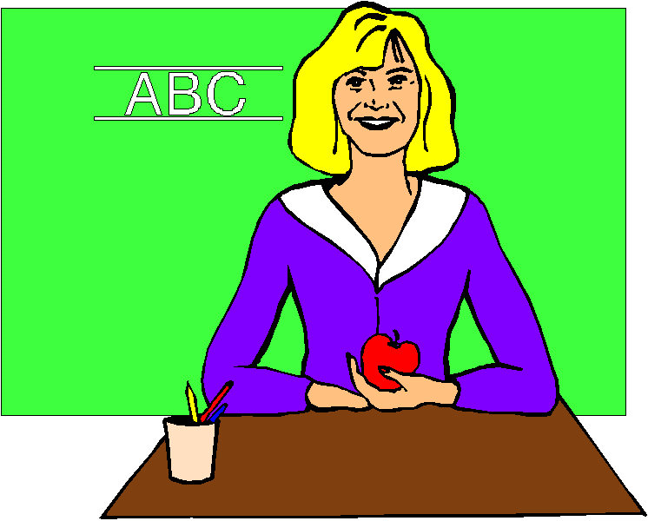
SJ

Slide 71
SJ
Responsible Dependable
Fair Practical
Role model Prepared
Dedicated In Control
Experienced Organized
Take Charge Step by step
Specific Precise
To the Point Rewards for Good Work

Slide 72
SP

Slide 73
SP
Unpredictable Laid Back
Opportunities Exploration
Fun! Entertaining
Sense of Humor Flexible
Interesting Variety
On the Go Patient
Different Perspectives Try New Things

Slide 74

NF

Slide 75
NF
Open Creative
Calm Honest
Empathic Personal
Mentor Tutor
Compassionate Enabler
Tolerant Helpful
Role Model Supportive

Slide 76
NT

Slide 77
NT
Knowledgeable Clear
Logical Thinking Creative
Competent Freedom
Analytical Inquisitive
Problem Solving Precise
Lab Experiences Praises Ingenuity
Challenging Thorough
Authoritative Intelligent

Slide 78

What if your personality does not match the teacher’s personality?

Slide 79
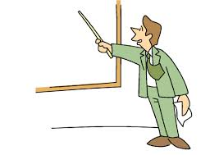

Adapt
Appreciate the Positives

Slide 80

Other Factors in Choosing a Major

Slide 81


Other Factors in Choosing a Major
Once your have completed the assessment, you may have several job options to consider.
          Research the job outlook to find out which jobs will be available and how much they pay.
Some students may opt for lower
Paying jobs that serve humanity
and provide personal fulfillment.

Slide 82

Checklist for a Satisfying Career

Slide 83
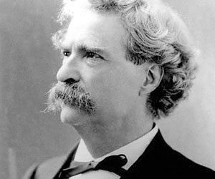
Keys to Success: Find Your Passion
The secret of success is making your vocation your vacation.
Mark Twain

Slide 84
Keys to Success: Find Your Passion
3 Types of Work:
A job (what you do for a paycheck)
A career (personally meaningful work)
A calling (a passionate commitment)
Martin Seligman says that you know you have found a calling when you are in the stare of flow. He defines flow as:
a complete absorption in an activity whole challenges mesh perfectly with your abilities.

Slide 85

Take the TruTalent Intelligences Asssessment in Chapter 3
This assessment helps you to think positively about your abilities and connect them to careers. Answer the questions honestly for the best results.

Slide 86
Multiple Intelligences
Developed by Howard Gardner
Defined as the human ability to solve problems or design or compose things valued in at least one culture.
He selected these intelligences because they are all represented by an area in the brain that are valued in different cultures.

Slide 87
Multiple Intelligences
Measures 9 Elements of Intelligence
Musical: hearing and remembering musical patterns
Interpersonal: understanding other people
Mathematical: working with numbers
Spatial: manipulating objects in space
Bodily-Kinesthetic: using your body
Linguistic: using language
Intrapersonal: understanding yourself
Naturalist: understanding the environment
Existential: pondering the meaning of life and our place in the universe

